Slide 1
Week 8
COGS 108 SP 2026
*By: Jason Chen & Jessica Cheng, Spring 2026

Slide 2
Due dates
A3: Thursday (05/21)
D7: Friday (05/22)

Slide 3
Supervised Learning vs Unsupervised Learning
Learning Modes & Classification Metrics
Before choosing a metric, identify the task and the error you care about.
Supervised Learning
Unsupervised Learning
Use labeled data
Learns relationship between features and known targets
Goal is prediction/classification
Has ground truth labels during training
Examples: Linear Regression, Logistic Regression, SVM, Random Forest, KNN
Use unlabeled data
Finds hidden structure or patterns in data
Goal is discovery, grouping, or dimensionality reduction
No ground truth labels provided
Examples: K-means, PCA, t-SNE, Hierarchical Clustering, DBSCAN
Supervised learning learns from known answers.
Unsupervised learning tries to discover patterns without answers.
Notes:
Supervised learning uses labeled data. The model learns from known targets. Examples include linear regression, logistic regression, SVM, and random forest.
Unsupervised learning uses unlabeled data. The goal is to find hidden structure or patterns. Examples include k-means, PCA, t-SNE, and hierarchical clustering.
The key distinction is whether the model has known answers during training. Supervised learning learns from known answers. Unsupervised learning tries to discover patterns without known answers.

Slide 4
Linear vs. non-linear classifiers
Linear vs. non-linear classifiers
Linear models
Non-Linear models
A machine learning method that separates different categories of data by drawing a straight line, flat plane, or flat hyperplane through the feature space.
E.g. Logistic Regression, Linear SVM, Perceptrons.
Stable, interpretable, and computationally inexpensive.
A machine learning method that separates data categories using curved lines or complex, irregular boundaries to capture intricate underlying patterns.
E.g. Kernel SVM, Random Forests, KNN, Deep Learning.
Powerful, flexible, and adaptive to data geometry.
Notes:
A linear classifier separates data using a straight line, a flat plane, or a hyperplane in higher dimensions. Logistic regression and linear SVMs are examples of linear models. These models are usually stable, interpretable, and computationally efficient.
A non-linear classifier can create curved or more complex decision boundaries. Kernel SVMs, random forests, k-nearest neighbors, and deep learning models are examples. These models can capture more complicated patterns, but they can also overfit more easily. The key idea is that model flexibility should match the structure of the data.

Slide 5
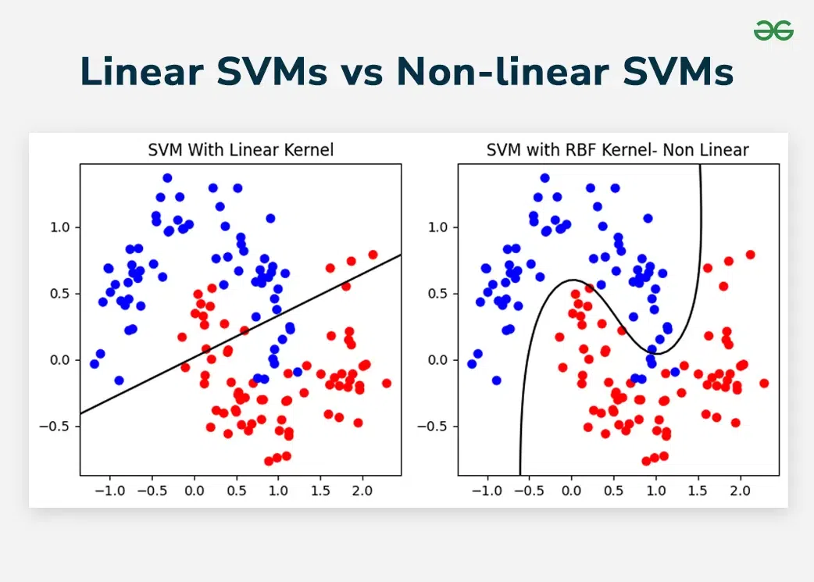
Linear vs. non-linear classifiers
Linear vs. non-linear classifiers
Different models can make very different boundaries on the same data.
Selection principle
Use validation or cross-validation to estimate generalization.
Notes:
Different classifiers can create very different decision boundaries on the same dataset. A linear model tries to separate the data with a straight boundary. A non-linear model can bend around the data more flexibly.
The important takeaway is not that one model is always better. The correct model depends on the dataset and the goal. We should use validation data or cross-validation to estimate how well a model generalizes. We should not choose a model only because it looks good on the training data.

Slide 6
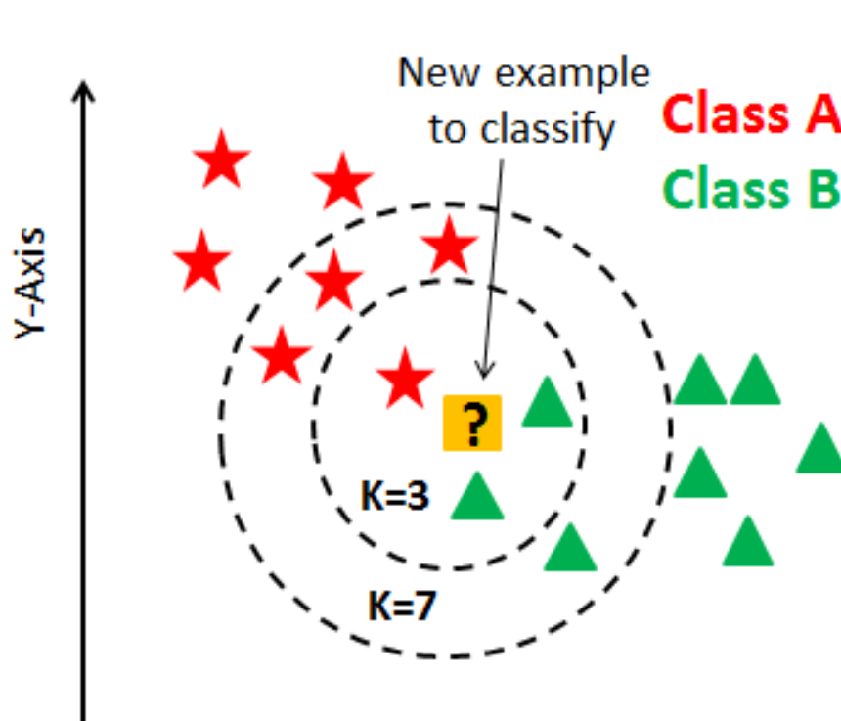
ALGORITHM - kNN
kNN predicts by local voting
A new point is classified from the labels of its nearest training points.
Core idea
Measure distance from the new point to training points. Then use the nearby labels to make a prediction.
Main hyperparameter
k controls how many neighbors vote. Small k is flexible. Large k is smoother.
Important preprocessing
Distance-based models care about scale, so numerical features often need standardization.
Notes:
k-nearest neighbors, or kNN, is based on local voting. When we classify a new point, the model looks at the closest training points and uses their labels to make a prediction.
The main hyperparameter is k. This controls how many neighbors get to vote. A small k means the model focuses on very local patterns. A larger k means the model averages over more points.
Because kNN uses distance, feature scaling matters. If one feature has much larger numbers than another feature, it can dominate the distance calculation. That is why standardizing numerical features is often important for kNN.

Slide 7
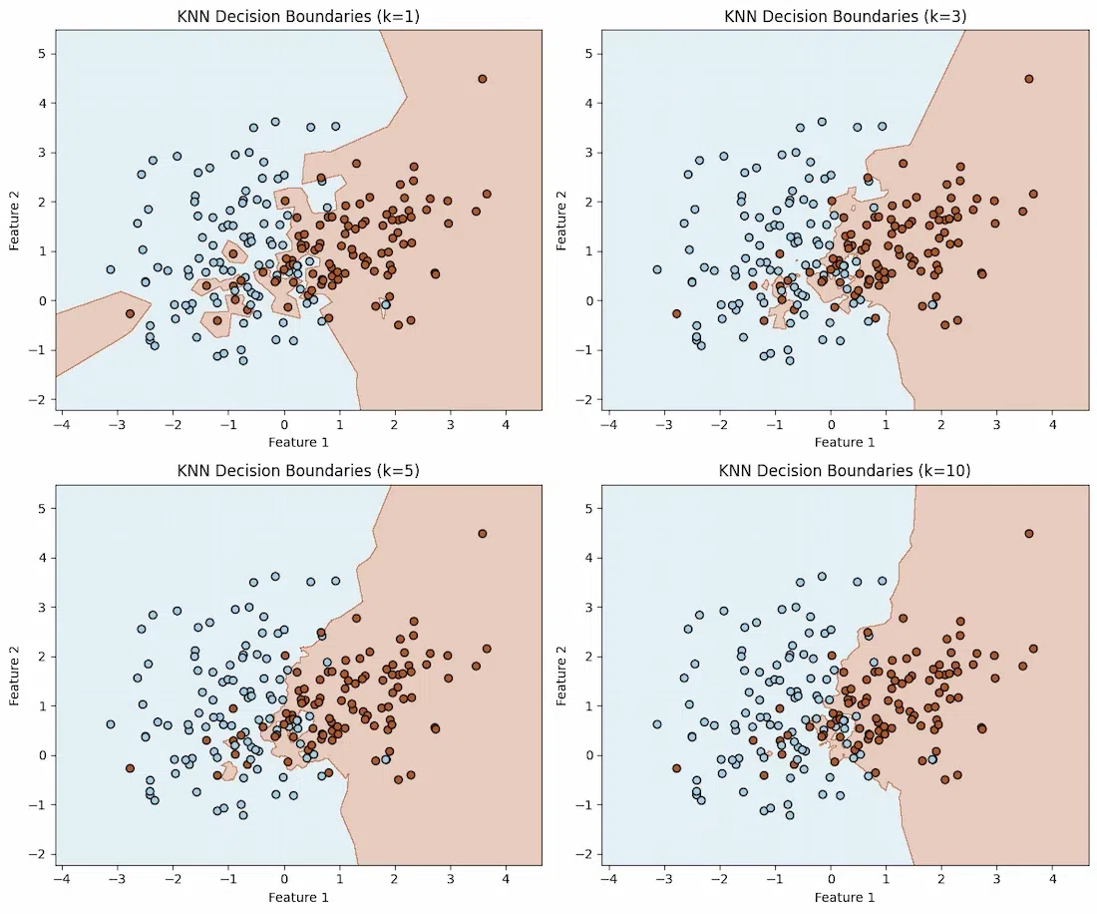
ALGORITHM - kNN
Changing k changes complexity
Small k can memorize local noise; larger k smooths the boundary and can underfit.
Lower k
More flexible, more variance, more noise-sensitive
More smoothing
Higher k
Smoother, Less variance, Risk of underfitting
Use validation performance, not just training performance, to choose k.
Notes:
Changing k changes how complex or flexible the kNN model is. When k is small, the model can follow local details very closely. This can make it sensitive to noise, and it may memorize patterns that do not generalize.
When k is larger, the decision boundary becomes smoother. This reduces variance, but if k becomes too large, the model may underfit and miss important structure.
The main principle is that we should choose k using validation performance, not training performance. Training performance alone can make overly flexible models look better than they really are.

Slide 8
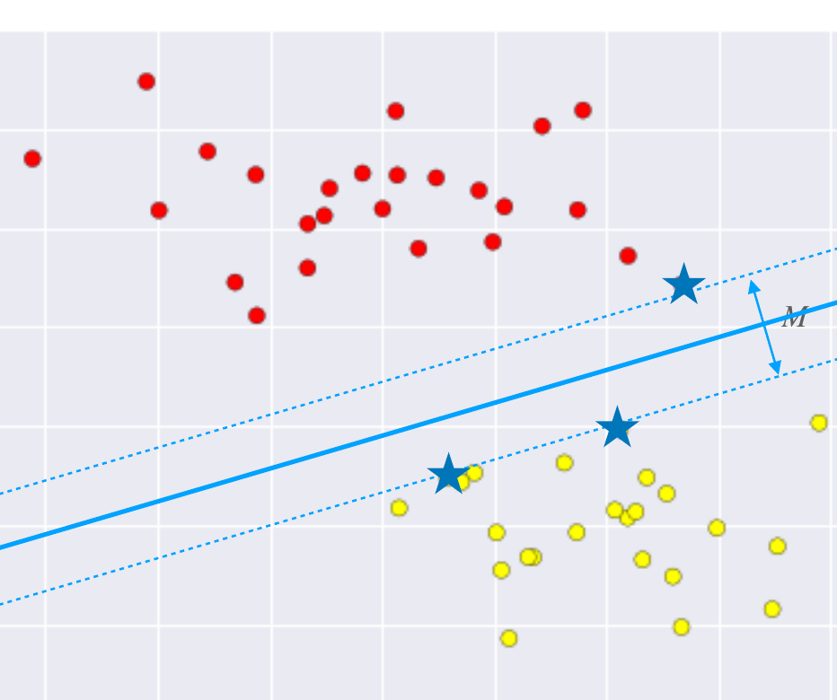
ALGORITHM - SVM
SVMs maximize the margin
The boundary is chosen to separate classes while keeping the nearest points as far away as possible.
Decision boundary
The separating line or plane. For a linear SVM, this boundary is linear in the feature space.
Margin
The empty space between the boundary and the closest training points.
Support vectors
The training points closest to the boundary. These points determine the margin.
Notes:
A support vector machine tries to find a decision boundary that separates the classes while maximizing the margin. The margin is the empty space between the decision boundary and the closest training points.
The closest training points are called support vectors. These points are especially important because they determine the position of the margin and the boundary.
For a linear SVM, the boundary is linear in the feature space. This means it is a straight line in two dimensions, a plane in three dimensions, or a hyperplane in higher dimensions.

Slide 9
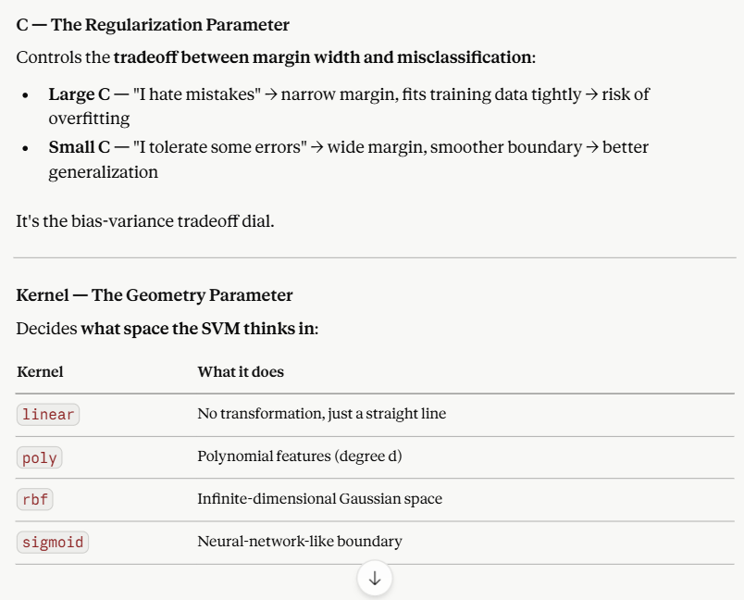

Slide 10
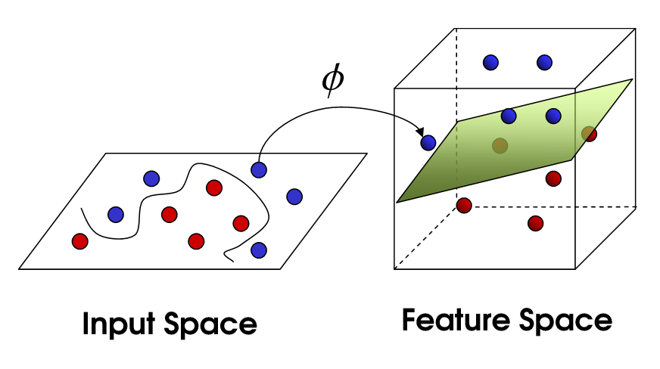
NON-LINEAR BOUNDARIES
Kernels make linear models act non-linear
A kernel transforms the feature space so a linear separator can solve a non-linear problem.
Original space
The classes may not be separable by a straight line.
Higher-dimensional space
After transformation, a linear boundary can work.
Kernel trick
The model can use this idea without explicitly building every transformed feature.
Notes:
Kernels allow models like SVMs to solve non-linear problems. The basic idea is to transform the data into a higher-dimensional feature space. In the original space, the classes may not be separable by a straight line. After transformation, a linear separator may work.
The kernel trick lets the model use this higher-dimensional idea without explicitly building every transformed feature. This is why a kernel SVM can create a non-linear boundary while still relying on a linear separator in the transformed feature space.

Slide 11
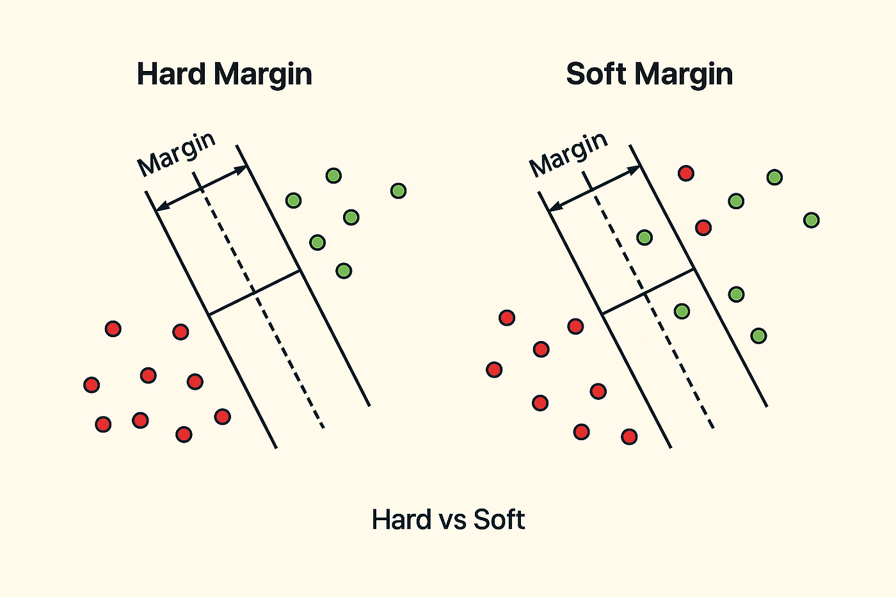
HYPERPARAMETER
C controls hard vs. soft margins
C changes how strongly the SVM tries to avoid training mistakes.
Large C
A harder margin. The model tries harder to classify training points correctly.
Small C
A softer margin. The model tolerates some mistakes to get a more robust boundary.
When data are noisy
A softer margin often generalizes better than forcing a perfect boundary.
Notes:
The SVM hyperparameter C controls how strongly the model tries to avoid mistakes on the training data. A large C acts more like a hard margin. The model tries harder to classify training points correctly, even if this creates a boundary that is less robust.
A small C creates a softer margin. The model allows some training mistakes in exchange for a simpler or more stable boundary.
When data are noisy, a softer margin can generalize better. The model does not need to chase every unusual point in the training set.

Slide 12
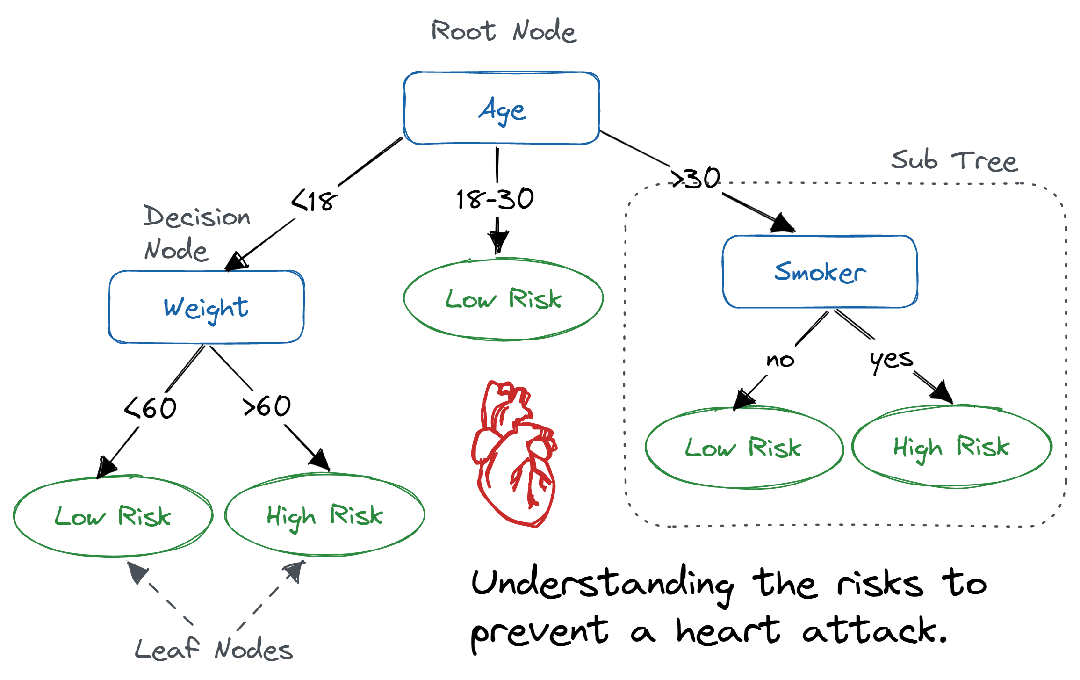
ALGORITHM - Decision Tree
Decision trees are readable rules
A tree repeatedly splits data using if–then statements.
Each node asks a rule about one feature.
Each split creates axis-aligned decision boundaries.
The tree chooses splits that reduce impurity.
More depth means more flexible rules and more overfitting risk.
Feature ≤ threshold?
left branch
right branch
Notes:
A decision tree makes predictions using a sequence of if-then rules. Each internal node asks a question about one feature, such as whether a value is less than or equal to a threshold.
Each split divides the data into smaller groups. These splits create axis-aligned decision boundaries, meaning the boundaries are perpendicular to one feature axis at a time.
Decision trees are useful because they are relatively interpretable. However, deeper trees can become very flexible and may overfit. The more depth we allow, the more complex the rules become.

Slide 13
IMBALANCED DATA
Accuracy can mislead
When one class is rare, a high overall accuracy can hide failure on the class we care about.
Accuracy
What fraction of all predictions were correct?
Problem
A model can look accurate by always predicting the majority class.
Rare positive class
Majority negative class
Fix
Check class-specific metrics such as recall, specificity, and precision.
Notes:
Accuracy measures the fraction of predictions that are correct. This can be useful, but it can also be misleading when the classes are imbalanced.
For example, if one class is very rare, a model can get high accuracy by always predicting the majority class. But that model may completely fail to detect the rare class that we actually care about.
That is why we need class-specific metrics. Recall, specificity, and precision help us understand different kinds of performance beyond overall accuracy.

Slide 14
CLASSIFICATION
Start by defining the positive class
TP, FP, FN, and TN are defined relative to the class labeled “positive.”
Predicted
+
−
+
TP
True positive
FN
False negative
Actual
−
FP
False positive
TN
True negative
Notes:
Before using terms like true positive, false positive, false negative, and true negative, we need to define the positive class.
A true positive means the model predicted positive and the actual class was positive. A false positive means the model predicted positive, but the actual class was negative. A false negative means the model predicted negative, but the actual class was positive. A true negative means the model predicted negative and the actual class was negative.
These labels are always relative to what we call the positive class. If the positive class changes, the interpretation of the confusion matrix changes too.

Slide 15
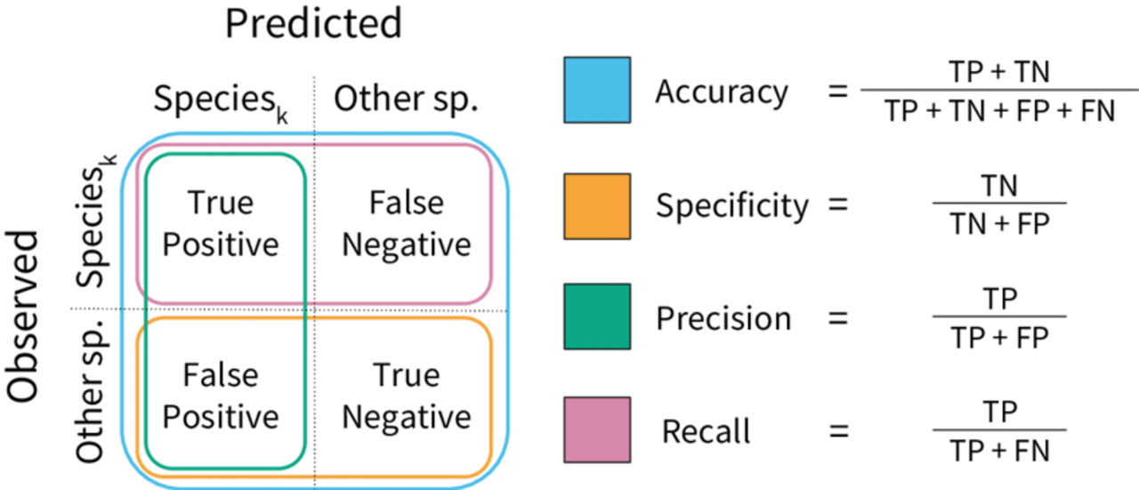
ASSESSMENT
Four common metrics answer different questions
Accuracy
Specificity
Of all examples, what percent were predicted correctly?
Of the actual negatives, what percent did we correctly reject?
Recall / Sensitivity
Precision / PPV
Of the actual positives, what percent did we detect?
Of the predicted positives, what percent were truly positive?
Shortcut: ask “What group is in the denominator?”
Notes:
Accuracy asks: out of all examples, what percentage did we predict correctly?
Recall, also called sensitivity, asks: out of the actual positives, what percentage did we detect?
Specificity asks: out of the actual negatives, what percentage did we correctly reject?
Precision, also called positive predictive value, asks: out of the examples predicted positive, what percentage were actually positive?
A useful shortcut is to ask what group is in the denominator. That tells you what population the metric is focusing on.

Slide 16
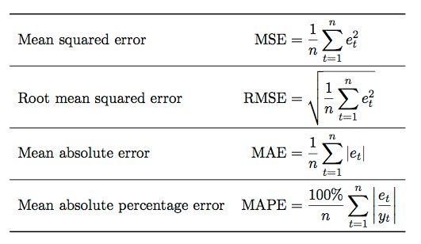
ASSESSMENT
Continuous targets need error metrics
For regression, we compare predicted values against true values.
MSE averages squared errors
RMSE = square root of MSE
MAE averages absolute errors
Squared-error metrics punish large errors especially strongly. MAE is less dominated by extreme outliers.
Notes:
For regression problems, the target is continuous rather than categorical. Instead of using accuracy or a confusion matrix, we compare predicted values with true values using error metrics.
Mean squared error averages the squared errors. Root mean squared error is the square root of mean squared error, so it is in the same units as the target variable. Mean absolute error averages the absolute size of the errors.
Squared-error metrics punish large errors especially strongly. MAE is less dominated by extreme outliers. So the best metric depends on what kind of prediction error matters most for the problem.

Slide 17
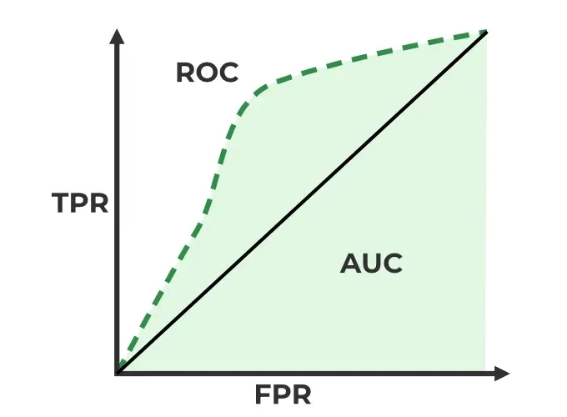
ASSESSMENT
ROC curves show threshold tradeoffs
AUC summarizes how well scores separate positives from negatives across thresholds.
ROC curve
Plots true positive rate against false positive rate as the threshold changes.
AUC
Area under the ROC curve. Higher values mean better separation.
Interpretation
Random-like performance is near 0.5 for balanced binary data. Perfect separation is 1.
Notes:
ROC curves are used for binary classification models that produce scores or probabilities. The ROC curve shows how the true positive rate and false positive rate change as the classification threshold changes.
AUC stands for area under the ROC curve. It summarizes how well the model separates positives from negatives across thresholds.
A higher AUC means better separation. Random-like performance is near 0.5 for balanced binary data, and perfect separation is 1. The important idea is that ROC-AUC evaluates ranking or separation, not just one fixed threshold.

Slide 18
SELECTION
Model selection prevents overfitting
Trying many models is allowed only if we evaluate them on data not used for fitting.
Algorithms
Hyperparameters
Features
Try kNN, SVM, decision trees, neural nets, and others.
Try k, C, kernel type, max depth, and more.
Try different predictor sets or engineered features.
Compare on validation data
If we tune using the test set, the test set stops being an honest estimate of future performance.
Notes:
Model selection means choosing among different algorithms, hyperparameters, and feature sets. For example, we might compare kNN, SVMs, decision trees, or neural networks. We might also compare different values of k, C, kernel type, or max depth.
Trying many models is allowed, but we need to compare them on data that were not used for fitting. This is why validation data matters.
The test set should not be used repeatedly for tuning. If we tune using the test set, the test set stops being an honest estimate of future performance.

Slide 19
WORKFLOW
Separate fitting, choosing, and final testing
The validation set is for choosing a model; the test set is for the final performance estimate.
1. Shuffle and split
3. Choose and refit
Create training, validation, and test data.
Pick based on validation, then refit using training plus validation.
2. Fit candidates
4. Final estimate
Train each candidate on training data.
Evaluate once on the test data.
Notes:
A reliable workflow separates fitting, choosing, and final testing.
First, shuffle and split the data into training, validation, and test sets. Second, train each candidate model on the training data. Third, choose the best candidate using validation performance. Then refit that selected model using the training plus validation data. Finally, evaluate once on the test set.
The validation set is for choosing the model. The test set is for estimating final performance. Keeping those roles separate helps prevent overfitting.

Slide 20
IMPLEMENTATION
A reliable sklearn recipe
The notebook shows the practical ingredients: preprocessing, fitting, assessment, and selection.
Raw data
Preprocess
Fit model
Evaluate
Select
Features + target
standardize, one-hot
kNN, SVM, tree
metrics + plots
CV / grid search
Standardize continuous features when distance or magnitude matters.
One-hot encode unordered categorical variables.
Use train_test_split, cross_val_score / cross_val_predict, GridSearchCV, and Pipeline as needed.
Use grouped or stratified split strategies when observations are not independent or classes are imbalanced.
Main implementation principle: avoid leakage between training, validation, and test data.
Notes:
The notebook workflow follows a standard machine learning recipe. We start with raw data, define features and the target, preprocess the features, fit models, evaluate performance, and select a model.
Preprocessing can include standardizing continuous features and one-hot encoding categorical variables. Standardization matters for models that depend on distance or feature magnitude. One-hot encoding is useful for unordered categorical variables.
In sklearn, useful tools include train_test_split, cross_val_score, cross_val_predict, GridSearchCV, and Pipeline. The main principle is to avoid leakage between training, validation, and test data.

Slide 21
Text Features
Text features: tokens, TF–IDF, and sentiment
For text data, the model sees engineered representations of words or tokens.
“The penalty kick went over the bar.”
Tokenization
Split text into units such as words, terms, or n-grams.
penalty
kick
went
over
bar
Term frequency
Inverse document frequency
Sentiment analysis
How common a term is inside one document.
Downweights terms that appear in many documents.
Infer emotional tone or polarity from text.
Preprocessing choices matter: tokenizer, stop words, stemming or lemmatization, and how to handle rare/common terms.
Notes:
For text data, models cannot directly understand raw sentences. We need to convert text into numerical or structured features.
Tokenization splits text into units, such as words, terms, or n-grams. Term frequency measures how common a term is within one document. Inverse document frequency downweights terms that appear in many documents, because those terms are usually less informative.
Sentiment analysis tries to infer emotional tone or polarity from text. Important preprocessing choices include the tokenizer, whether to remove stop words, whether to stem or lemmatize words, and how to handle very rare or very common terms.

Slide 22
Quiz Time
NO Phone, NO Communication, No Notes
Access Code: takequiz07

Slide 23
Your time to …
Work on projects
Finish Checkpoint
Finish D7 & A3
Have fun...

